Slide 1

MARQUIS TECHNOLOGIES
NR(5G) LOCATION: United Kingdom, London, BrentFord, Slough, Hammersmith
Notes:
CONFIDENTIAL

Slide 2
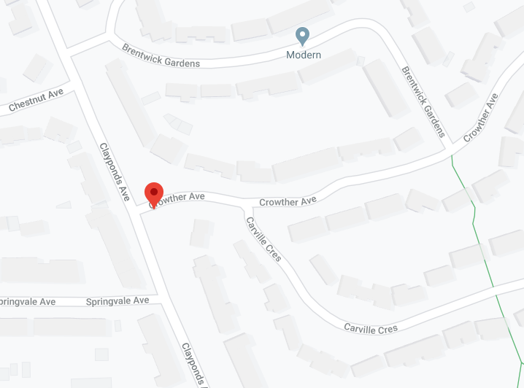
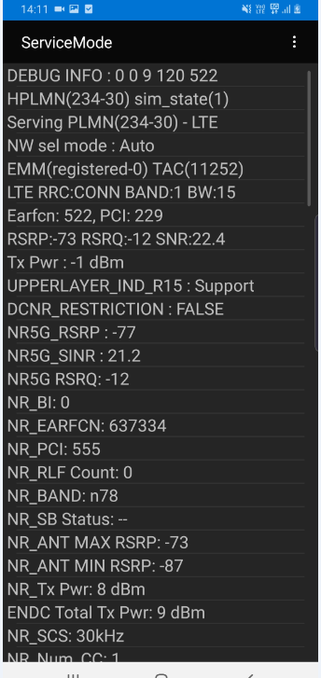
5G NR Location (Good Coverage)
EE Location (NR-RSRP -60dBm ~ -80dBm)
Location- Clayponds Ave, Brentford, TW8 9QE

Slide 3
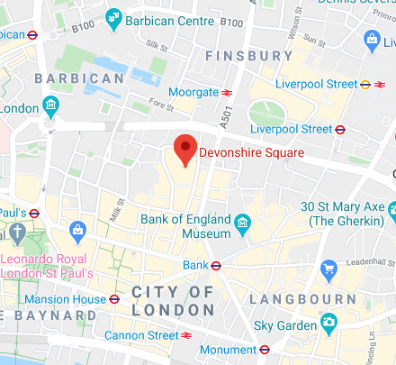
EE Central London Location
Location - Devonshire Square Parking, Spitafields, London. EC2M 4YE

Slide 4
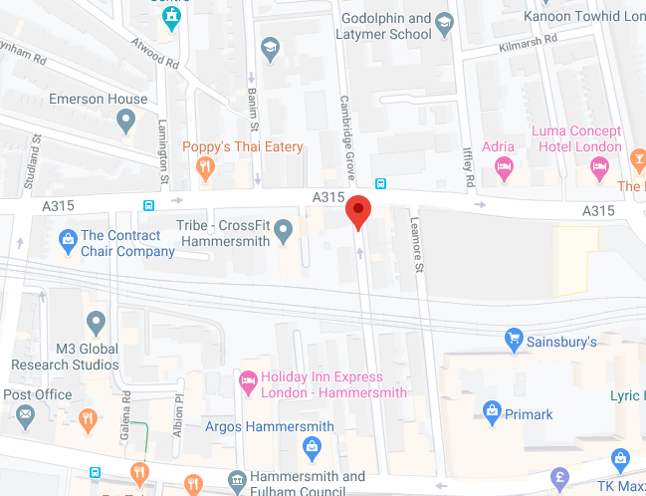
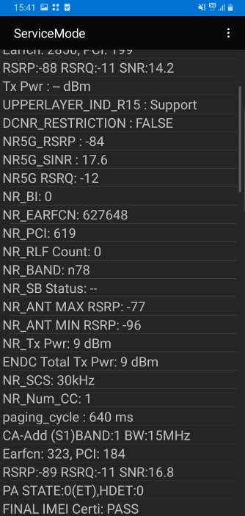
5G NR Location (Good Coverage)
Vodafone Location (NR-RSRP -70dBm ~ -80dBm)
Cambridge Grove, Hammersmith, London

Slide 5
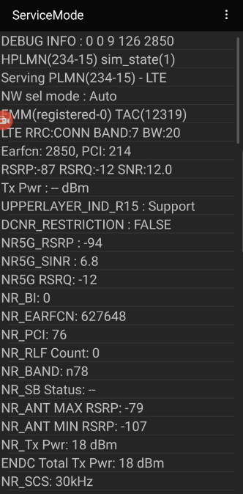
Vodafone Central London Location
Location - Devonshire Square Parking, Spitafields, London. EC2M 4YE

Slide 6
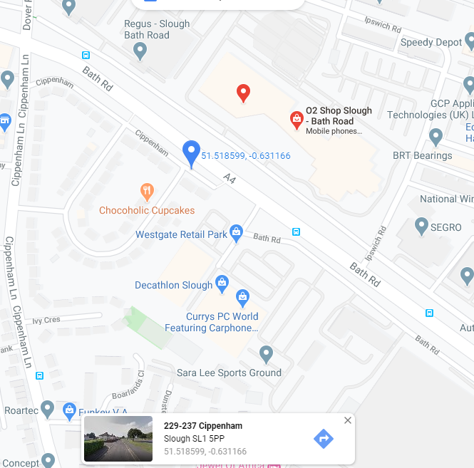
(O2 NR Location- Good Coverage) (NR-RSRP: -55dBm ~ 70dBm)
Location- 229-237 Cippenham,Slough SL1 5PP.
Landmark: Opposite of O2 Slough office

Slide 7
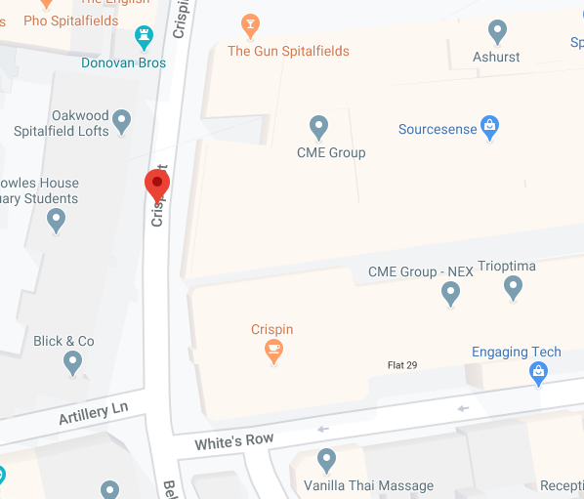
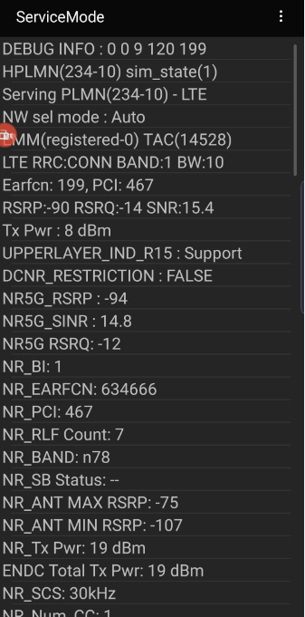
(O2 NR Location- Good Coverage) (NR-RSRP: -70dBm ~ 90dBm)
Location- Crispin St Spitalfields, Central London, E1 6HQ

Slide 8
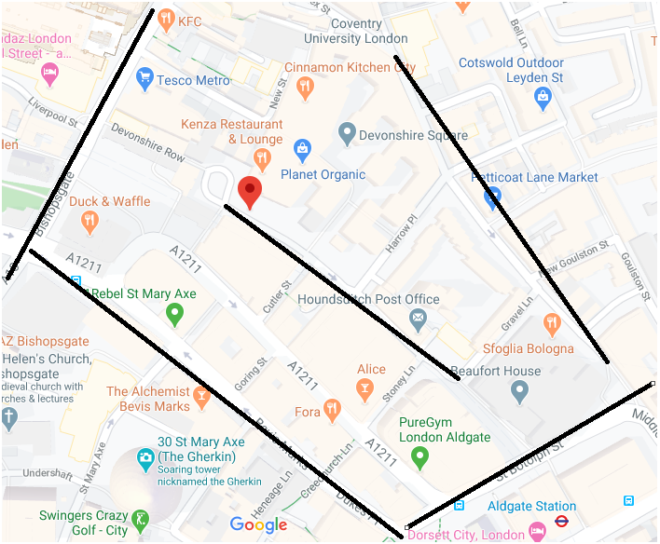
5G to 5G NR intra Handover for EE and Vodafone operator
Location- Near to Devonshire Square, EC2M 4YE

Slide 9
Thank You
Marquis Technologies Pvt Ltd
Rahul Solanki

