Slide 1

MARQUIS TECHNOLOGIES
NR(5G) LOCATION: Milan, Italy Europe
Notes:
CONFIDENTIAL

Slide 2
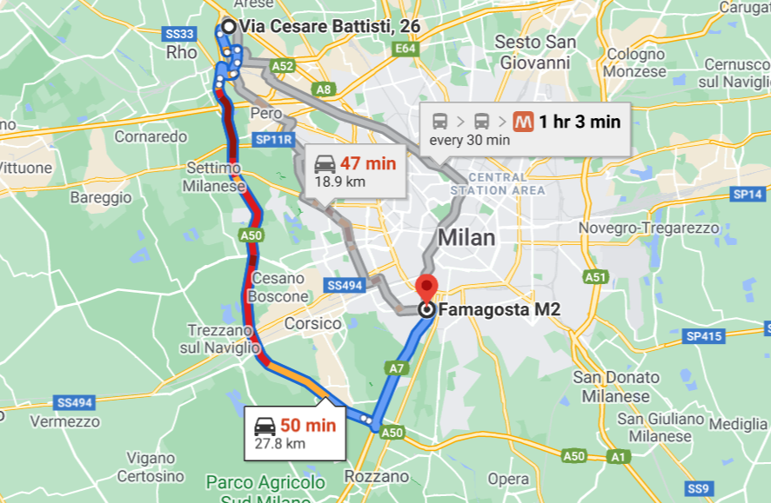
5G NR Location for VDF Operator
RAT (NR-RSRP -85dBm ~ -95dBm)
Location- Milan, Italy

Slide 3
5G NR Location for Iliad Operator
RAT (NR-RSRP -85dBm ~ -95dBm)
Location- Milan, Italy

Slide 4
5G NR Location for Windtre Operator
RAT (NR-RSRP -89dBm ~ -100dBm)
Location- Milan,Italy

Slide 5
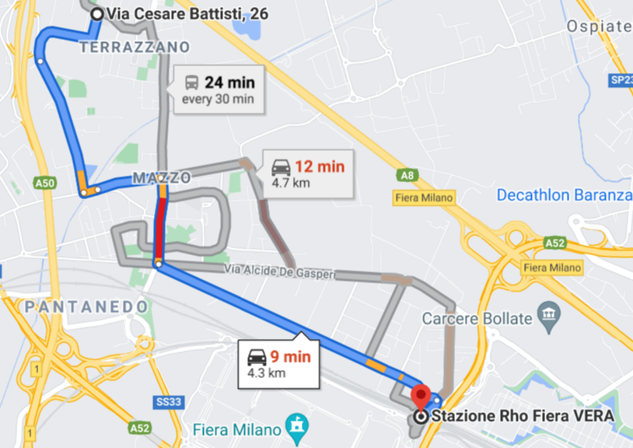
5G NR Location for Tim Operator
RAT (NR-RSRP -89dBm ~ -100dBm)
Location- Milan,Italy

Slide 6
Thank You
Marquis Technologies Pvt Ltd
Zahid Khatri

