Slide 1

MARQUIS TECHNOLOGIES
NR(5G) LOCATION: Czech, Europe
Notes:
CONFIDENTIAL

Slide 2
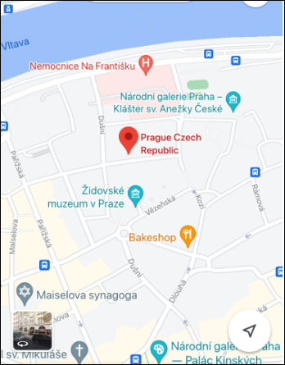
5G NR Location for O2 Operator
RAT (NR-RSRP -90dBm ~ -100dBm)
Location- Prague, Czech

Slide 3
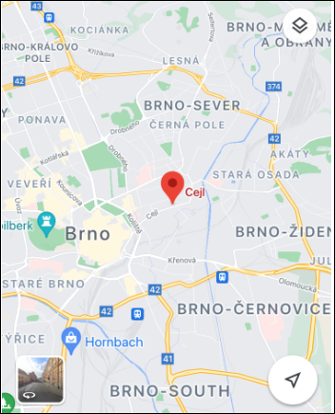
5G NR Location for T-mobile Operator
RAT (NR-RSRP -90dBm ~ -100dBm)
Location- Brno, Cejl Czech

Slide 4
5G NR Location for Vodafone Operator
RAT (NR-RSRP -90dBm ~ -100dBm)
Location- Brno, Cejl Czech

Slide 5
Thank You
Marquis Technologies Pvt Ltd
Nagarjun Goud

