Slide 1

MARQUIS TECHNOLOGIES
NR(5G) LOCATION: Barcelona, Spain
Notes:
CONFIDENTIAL

Slide 2
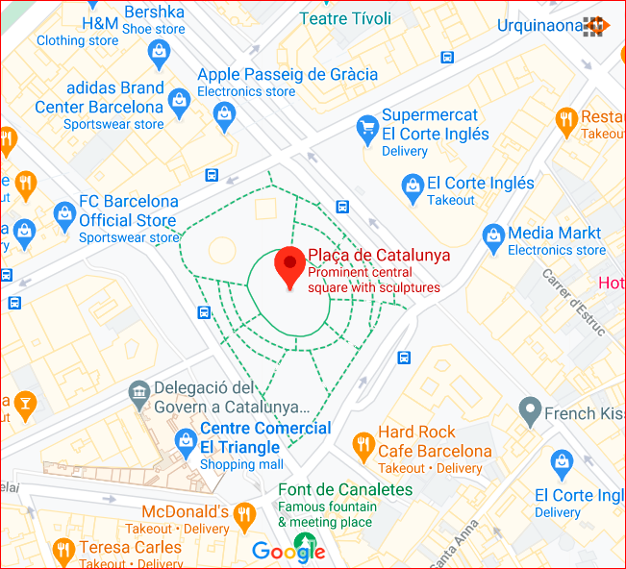
5G NR Location (Good Coverage) Orange/Movistar/Vodafone Location (NR-RSRP -60dBm ~ -90dBm) Location- Placa de Catalunya, Barcelona

Slide 3
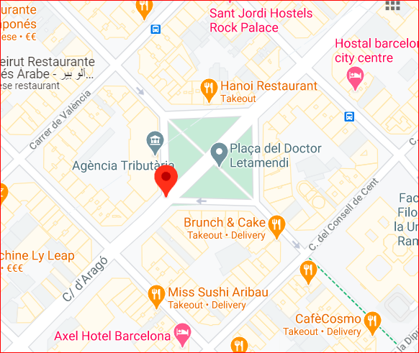
5G NR Location for Orange operator Location – Placa del Doctor Letamendi

Slide 4
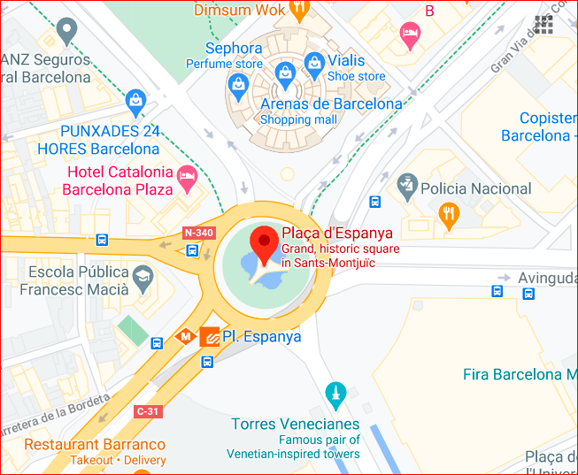
5G NR location for Vodafone/Movistar Location: Placa d’Espanaya

Slide 5
Thank You Marquis Technologies Pvt Ltd Naman Trivedi

