Slide 1
MARQUIS TECHNOLOGIES
Drive Route

Slide 2
(Varanasi)
Country | India
Continent | Uttar Pradesh
City | Varanasi
Time Zone | GMT +05:30 India Standards Time

Slide 3
Operators in Location
MCC | MNC | Operator
405 | 871 | Jio
405 | 54 | Airtel
Jio operator Network Info
RAT | Band | Comment
5G | N78
4G | B3,B5,B40
3G | NA
2G | NA
Airtel operator Network Info
RAT | Band | Comment
5G | N78
4G | B1, B3, B5, B40
3G | NA
2G | DSC 1800

Slide 4
Drive Route operator
Near Cell :-Stationary: RSRP: -60dbm to -75dbm
Mixed :-Mobility: RSRP : -75dbm to -95dbm
Cell Edge :-Stationary: RSRP : -95dbm to -115dbm

Slide 5
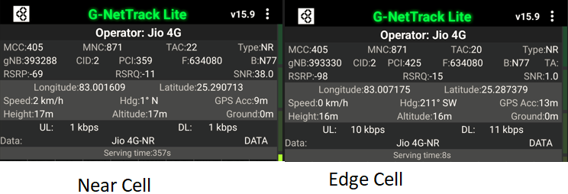
JIO

Slide 6
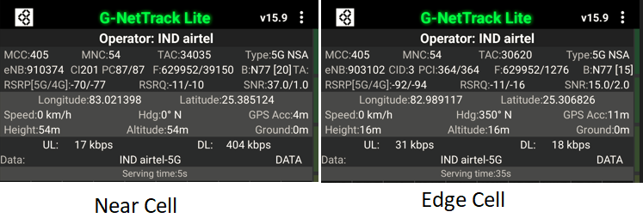
AIRTEL

Slide 7
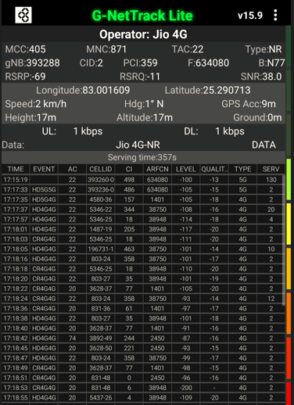
Near Cell screenshots of all band with Network INFO. Which include 5G also.
Operator: Jio
Band: 78
Cell ID: 2
E-ARFCN : 634080
RSRP: -60dBm to -75dBm

Slide 8
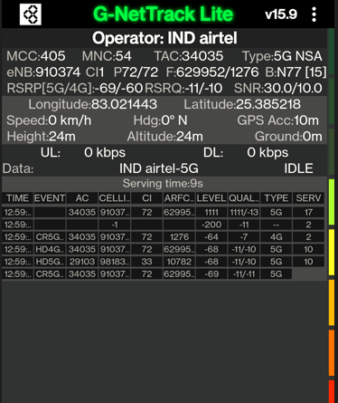
Near Cell screenshots of all band with Network INFO. Which include 5G also.
Operator: Airtel
Band: 78
Cell ID: 1
E-ARFCN : 629952
RSRP: -60dBm to -75dBm

Slide 9
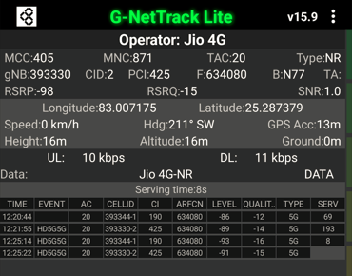
Edge Cell screenshots of all band with Network INFO. Which includes 5G also
Operator: Jio
Band: 78
Cell ID: 2
E-ARFCN : 634080
RSRP: -95dbm to 115dbm

Slide 10
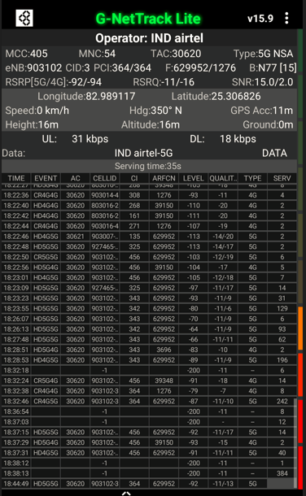
Edge Cell screenshots of all band with Network INFO. Which includes 5G also
Operator: Airtel
Band: 40
Cell ID: 3
E-ARFCN : 629952
RSRP: -95dbm to 115dbm

Slide 11
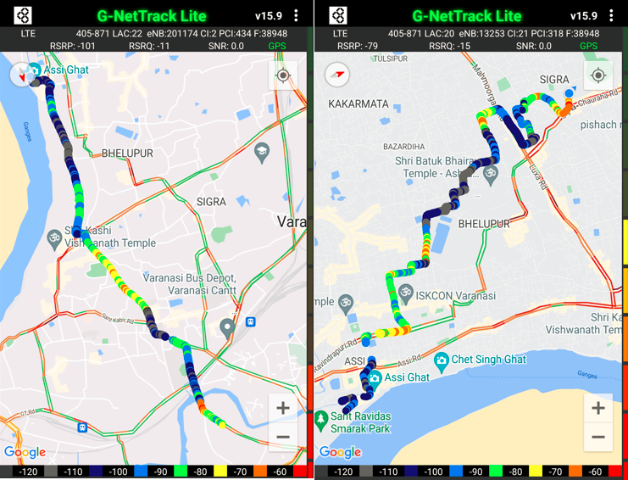
( Mixed Mobility Area_JIO)

Slide 12
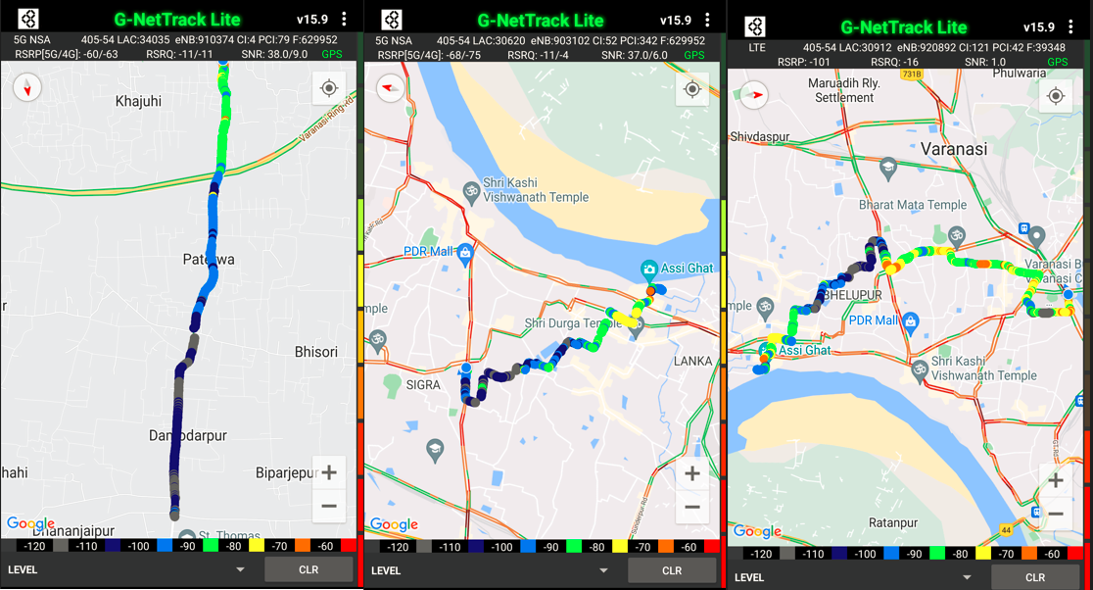
( Mixed Mobility Area_ Airtel)

Slide 13
SRVCC screenshots of all band with Network INFO.
Operator: Jio
Band:
Cell ID: 2
E-ARFCN :
RSRP: -60dBm to -75dBm
Operator doesn’t have legacy network.

Slide 14
SRVCC screenshots of all band with Network INFO.
Operator: Airtel
Band:
Cell ID: 2
E-ARFCN :
RSRP: -60dBm to -75dBm
No locations found.

Slide 15
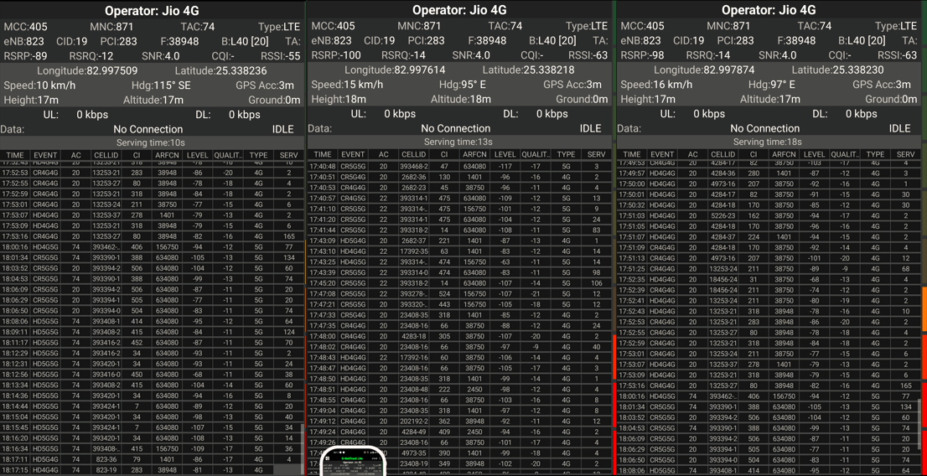
Band Handover_Jio– It will include all 5G to 4G.
Operator: Jio
Band Handover: N78-B40-B3-B40-N78
E-ARFCN : 634080-38948-1401-38750-156750

Slide 16
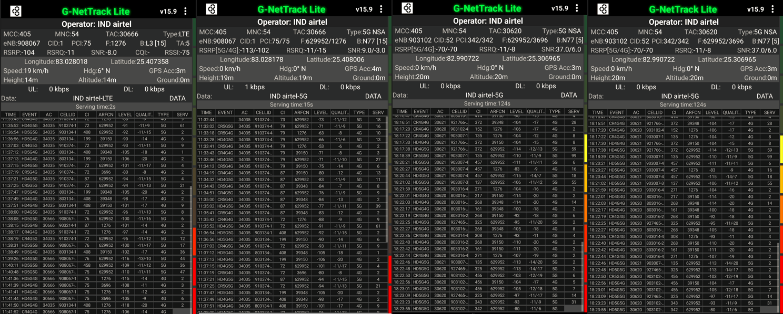
Band Handover_Airtel – It will include all 5G to 4G , 4G to 2G.
Operator: Airtel
Band Handover: B40-B3-B40
E-ARFCN : 39025-1300-39025

Slide 17
(Reselection_Jio)

Slide 18
(Reselection_Airtel)

Slide 19
( Drive Route covered during mobility_Jio. )

Slide 20
( Drive Route covered during mobility_Airtel. )

Slide 21
THANK YOU
MARQUIS TECHNOLOGIES
www.marquistech.com

