Slide 1
MARQUIS TECHNOLOGIES
Drive Route

Slide 2
CHENNAI
Country | INDIA
Continent | TAMIL NADU
City | CHENNAI
Time Zone | ---

Slide 3
Operators in Location
MCC | MNC | Operator
404 | 40 | AIRTEL
405 | 862 | JIO
404 | 84 | VI
operator Network Info(Airtel)
RAT | Band | Comment
5G | N77
4G | Band 1 (FDD-2100) Band 3 (FDD-1800),Band 8(FDD-390) Band 40 (TDD-2300)
3G | -
2G | GSM900, 1800
operator Network Info(JIO)
RAT | Band | Comment
5G | -
4G | LTE 2300 MHz –TDD(Band 40), LTE 850 MHz – FDD(Band 5) , LTE 1800 MHz –FDD(Band 3)
3G | -
2G | -
operator Network Info(VI)
RAT | Band | Comment
5G | -
4G | LTE 2100 MHz – FDD(Band 1), LTE 1800 MHz –FDD(Band 3)
3G | -
2G | GSM900, 1800

Slide 4
Drive Route operator
Near Cell :-Stationary: RSRP: -60dbm to -75dbm
Mixed :-Mobility: RSRP : -75dbm to -95dbm
Cell Edge :-Stationary: RSRP : -95dbm to -115dbm

Slide 5
AIRTEL

Slide 6
OPERATOR | Mobility Scenario | Location tested | Longitude/Latitude
AIRTEL | 5G to 4G HO Spot | Marina Road | 80.2824, 13.0500
 | SRVCC to 2G | St thomas Mount Road | 80.1923,13.0051
 | IRAT | kamakshi Hospital Road | 80.2362,12.9416
 | Good Coverage For Testing | Mylapore | 80.2676,13.0368
 | Poor Coverage For Testing | Tansi Nagar,Velachery | 80.2180,12.9815

Slide 7
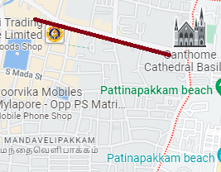
Near Cell screenshots of all band with Network INFO. Which include 5G also.
Operator: Airtel
Band: 40
Cell ID: 2
E-ARFCN : 39025
RSRP: -60dBm to -75dBm

Slide 8
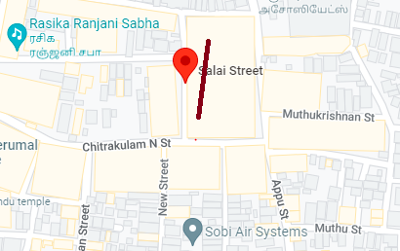
Edge Cell screenshots of all band with Network INFO. Which includes 5G also
Operator: Airtel
Band: 40
Cell ID: 2
E-ARFCN : 39150
RSRP: -95dbm to 115dbm

Slide 9
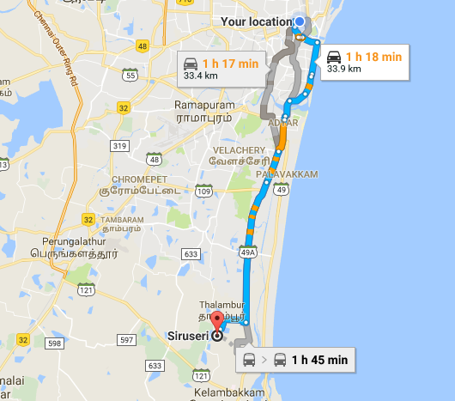
Mixed Mobility:- Siruseri, Chennai, Tamil Nadu
RSRP: -65dbm to -110dbm

Slide 10
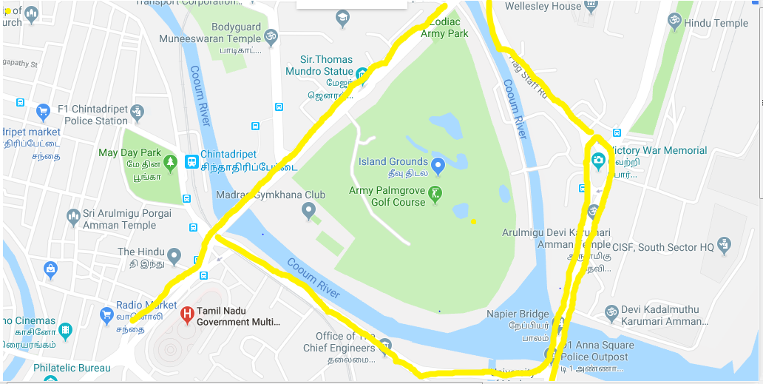
SRVCC screenshots of all band with Network INFO.
Operator: Airtel
Band: 40
Cell ID: 2
E-ARFCN : 39150
RSRP: -80dBm to -110dBm

Slide 11
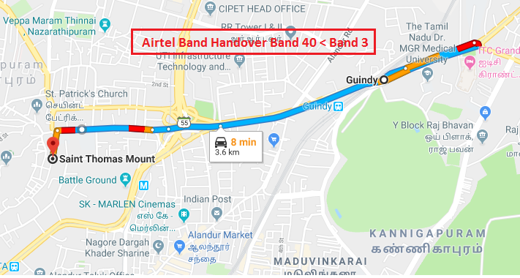
Band Handover – It will includes all 5G to 4G
Operator: Airtel
Band Handover: B40-B3-B40
E-ARFCN : 39150-1800-39150

Slide 12
(Reselection)

Slide 13
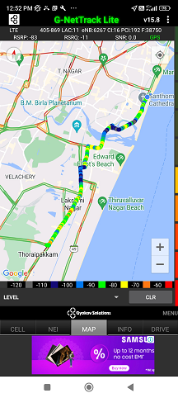
( Drive Route covered during mobility. )

Slide 14
THANK YOU
MARQUIS TECHNOLOGIES
www.marquistech.com

