Slide 1
MARQUIS TECHNOLOGIES
Drive Route

Slide 2
(Location Name)
Country | INDIA
Continent | ASIA
City | BANGALORE
Time Zone | ---

Slide 3
Operators in Location
MCC | MNC | Operator
404 | 45 | AIRTEL
- | -
- | -
operator Network Info
RAT | Band | Comment
5G | N277
4G | BAND 1,3,8,40
3G | NA
2G | BAND 3
operator Network Info
RAT | Band | Comment
5G | -
4G | -
3G | -
2G | -
operator Network Info
RAT | Band | Comment
5G | -
4G | -
3G | NA
2G | -

Slide 4
Drive Route operator
Near Cell :-Stationary: RSRP: -60dbm to -75dbm
Mixed :-Mobility: RSRP : -75dbm to -95dbm
Cell Edge :-Stationary: RSRP : -95dbm to -115dbm

Slide 5
AIRTEL

Slide 6
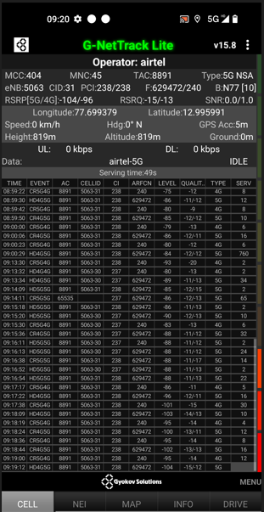
Operator: Airtel
Band: N77
Cell ID: 31
E-ARFCN : 629472/240
RSRP: -95dbm to 115dbm

Slide 7
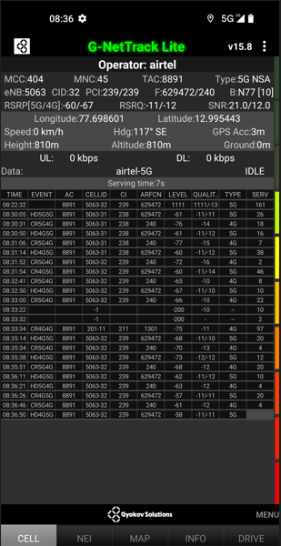
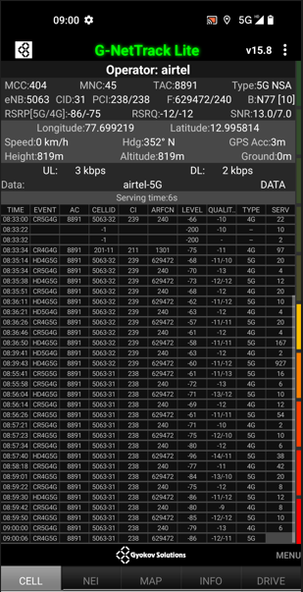
NEARCELL AND MIXEDCELL

Slide 8
SRVCC screenshots of all band with Network INFO.
Operator: Airtel
Band: 40
Cell ID: 2
E-ARFCN : 39025
RSRP: -60dBm to -75dBm

Slide 9
Band Handover – It will include all 5G to 4G , 4G to 3G.
Operator: Airtel
Band Handover: B40-B3-B40
E-ARFCN : 39025-1300-39025

Slide 10
(Reselection)

Slide 11
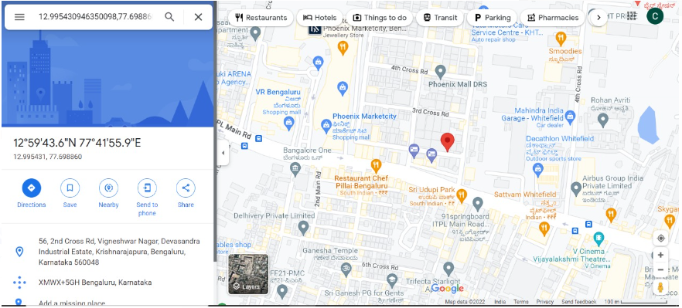
( Drive Route covered during mobility. )

Slide 12
THANK YOU
MARQUIS TECHNOLOGIES
www.marquistech.com

