Slide 1
MARQUIS TECHNOLOGIES
4G Drive Route of Peru(Lima)

Slide 2
Operator Information
Operator Name | 5G Band | Dedicate Mode/NSA/SA | Band Combination (NR + LTE) | 4G Band | 3G Band
Movistar | Not supported | Not Applicable | Not Applicable | 4, 28 | 850, 1900 MHz
Claro | In tests | Not Applicable | Not Applicable | 2, 7, 28 | 850, 1900 MHz
Bitel | Not supported | Not Applicable | Not Applicable | 7, 8 | 900, 1900 MHz
Entel | In tests | Not Applicable | Not Applicable | 4, 28 | 850, 1900 MHz

Slide 3
Services Supported by Operators
Operator | USSD | VoLTE | ViLTE | MRAB | CSFB | VoWiFi | ViWiFi | VoWiFi support in Airplane mode | CA Combination | SRVCC to 3G/2G
Movistar | Yes | Yes | Yes | Yes | Yes | Yes | No | Yes | 2CC: B4+B28 | Yes
Claro | Yes | Yes | Yes | Yes | Yes | Yes | No | Yes | 2CC: 7C, B2+B7, B2+B28, B28+B7 3CC: B7C+B28 | Yes
Bitel | Yes | No | No | No |  | No | No | No | N/A | No
Entel | Yes | Yes | No | Yes | Yes | Yes | No | Yes | 2CC: B4+B28 | Yes

Slide 4
RSRP Criteria
Near Cell :-Stationary: RSRP : -55dbM to -75dbm
Cell Edge :-Stationary: RSRP : -90dbM to -105dbM
Mixed :-Mobility: RSRP : -55dbM to -120dbM

Slide 5
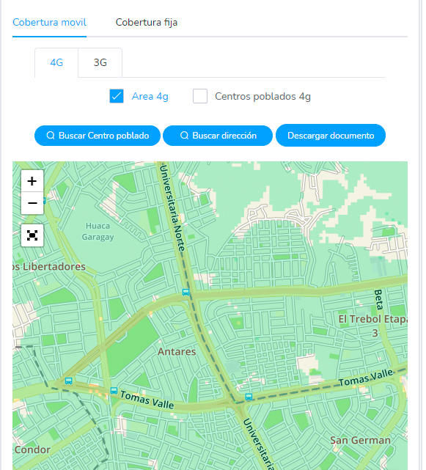
Bitel Solo 4G location

Slide 6
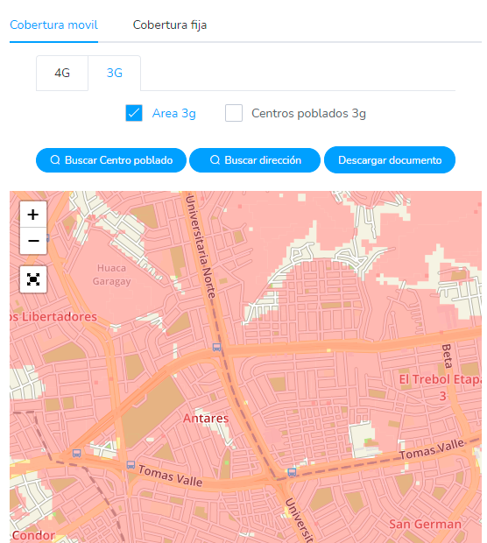
Bitel solo 3G location

Slide 7
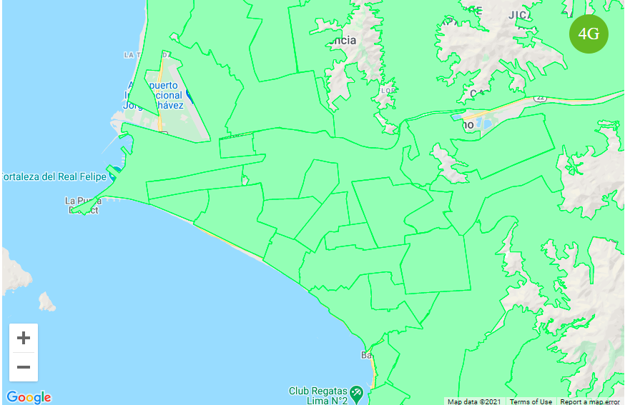
Movistar solo 4G location

Slide 8
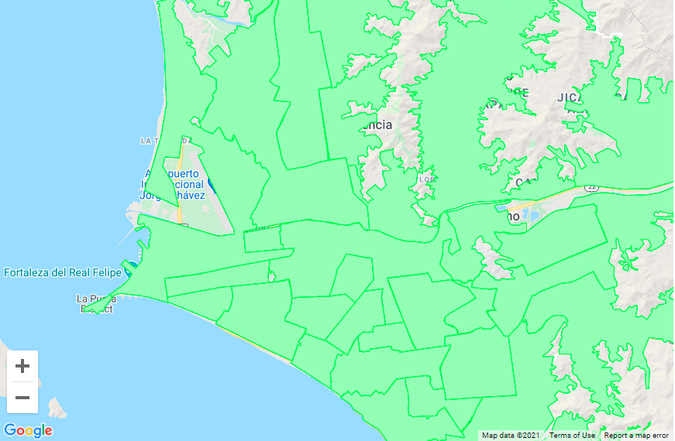

Movistar solo VOLTE location

Slide 9
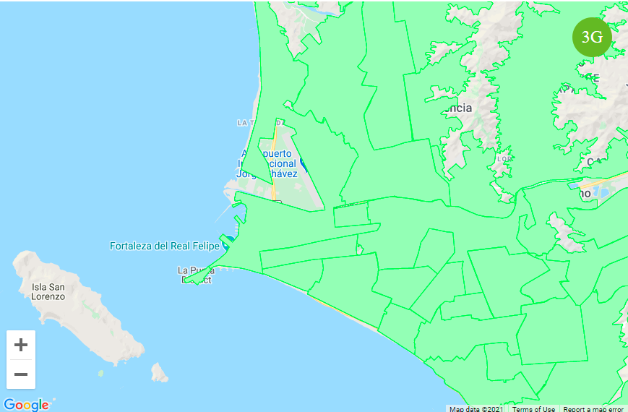
Movistar solo 3G location

Slide 10
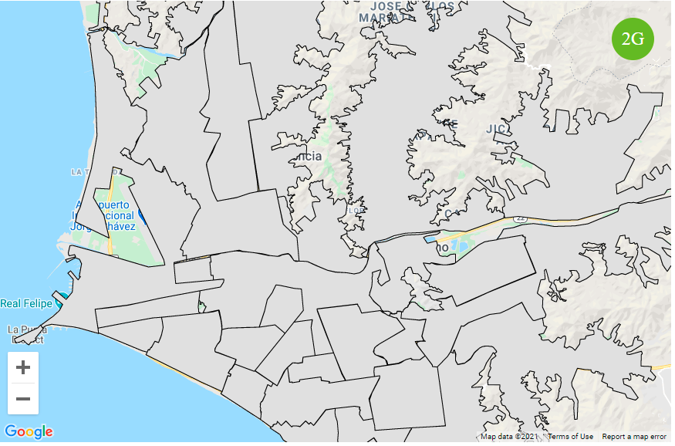
Movistar solo 2G location

Slide 11
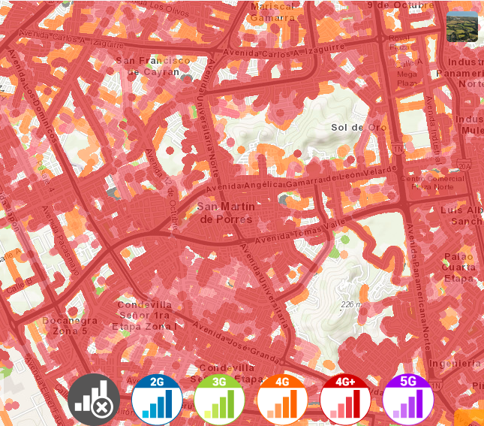
Claro SRVCC Location: San Martin de Porres, Lima, Peru
-12.0097615,-77.0877308 -12.003706,-77.077410
-12.014662,-77.098910 -12.014158,-77.076423

Slide 12
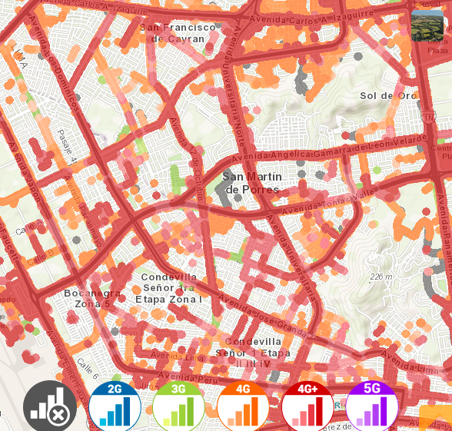
Movistar SRVCC Location: San Martin de Porres, Lima, Peru
-12.0097615,-77.0877308 -12.003706,-77.077410
-12.014662,-77.098910 -12.014158,-77.076423

Slide 13
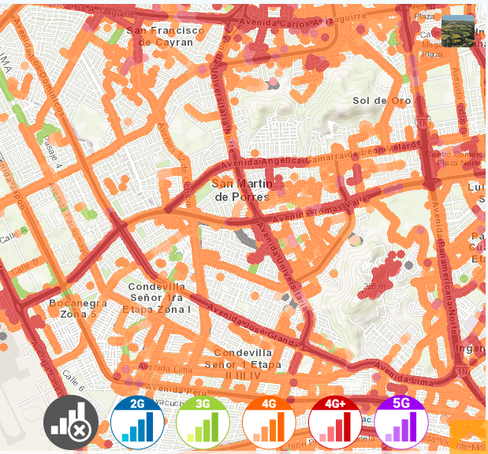
Entel SRVCC Location: San Martin de Porres, Lima, Peru
-12.0097615,-77.0877308 -12.003706,-77.077410
-12.014662,-77.098910 -12.014158,-77.076423

Slide 14
THANK YOU
MARQUIS TECHNOLOGIES
www.marquistech.com

